Slide 1
Module 3: Individual Peacekeeping Personnel
Lesson
3.11
Road Safety

Slide 2
Relevance
Rules and regulations to use UN-provided vehicles
Create safe environment for all
UN Core Pre-Deployment Training Materials 2017

Slide 3
Learning Outcomes
Learners will:
Explain what is required to drive UN vehicles
List four basic UN rules of road safety
Describe defensive driving
Explain UN’s expectations for use and control of vehicles, including handling and reporting of accidents and incidents
UN Core Pre-Deployment Training Materials 2017

Slide 4
Lesson Overview
Importance of Road Safety
Major Causes of Vehicle Accidents
Three Goals for Road Safety
Use of UN Vehicles
Four Basic UN Rules on Driver Safety
Defensive Driving Techniques
Vehicle Accidents & Incidents
Administrative & Disciplinary Actions
UN Core Pre-Deployment Training Materials 2017

Slide 5
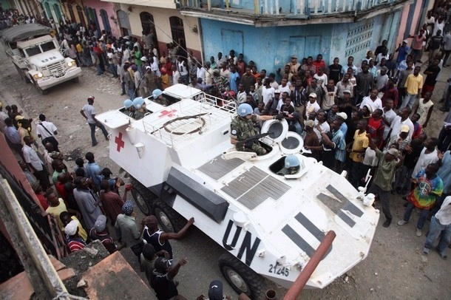
1. Why is Road Safety Important?
Accidents result in:
Loss of life and injury
Financial losses
Reduced operational capability
Negative public image
UN Core Pre-Deployment Training Materials 2017

Slide 6
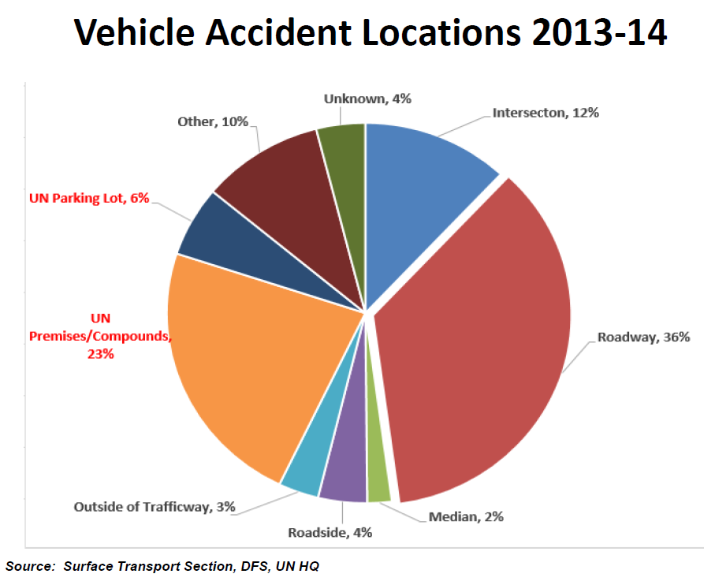
2. Major Causes of Vehicle Accidents
UN Core Pre-Deployment Training Materials 2017

Slide 7
3. Three Goals for Road Safety
Prevention of road accidents to the fullest extent possible
Mitigation of injury and damage when accidents do occur
Assimilation of ‘lessons learnt’ from mission and road accidents
UN Core Pre-Deployment Training Materials 2017

Slide 8
4. Use of UN Vehicles
Valid UN driver’s permit
OFFICIAL DUTIES only
Only transport authorized persons
UN Core Pre-Deployment Training Materials 2017

Slide 9
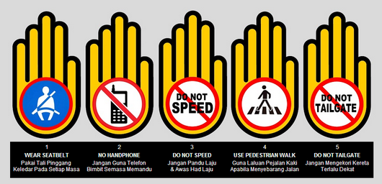
5. Four Basic UN Rules on Driver Safety
Wearing of seatbelts is mandatory
Driving under the influence of alcohol or drugs is strictly prohibited
Drivers are prohibited from using mobile phones
The speed limits, as posted by local authorities and in UN areas, must be observed at all times
UN Core Pre-Deployment Training Materials 2017

Slide 10
6. Defensive Driving
The act or practice of operating a vehicle to avoid collisions and accidents regardless of the conditions and/or actions of the drivers and others around you
Based on effective observation, good anticipation and control
UN Core Pre-Deployment Training Materials 2017

Slide 11
7. Vehicle Accidents & Incidents
Accident: an unintentionally caused traffic event – the event must be directly related to a driver’s operation of the vehicle
Incident: a reportable event, which involves damage to a motor vehicle and is NOT directly related to a driver’s operation of the vehicle
UN Core Pre-Deployment Training Materials 2017

Slide 12
8. Administrative & Disciplinary Actions
Class | Violations/Events
1 | Failure to comply with the UN instructions governing the use and security of UN vehicles as described in the Manual; failure to comply with other local traffic rules and regulations; reckless driving; causing unfair wear and tear; failure to use a seat belt; exceeding speed limits by less than 20 kph
2 | Causing minor traffic accident, where the UN driver is partly or wholly at fault and does not cause any injuries or significant property damage; demonstrated lack of competence or sense of responsibility; driving with an expired permit; transportation of unauthorized passengers or items; exceeding speed limits by more than 20 kph
3 | Causing major traffic accident, where the UN driver is partly or wholly at fault and causes death/injury or significant property damage; driving under the influence of drugs or alcohol; driving without a permit; failure to report an accident or misrepresentation of an accident; repeating speeding offence more than three times

Slide 13
Summary of Key Messages
What is required to drive UN vehicle
Four basic UN rules of road safety
Defensive driving
UN’s expectations for use and control of vehicles, including handling and reporting of accidents and incidents
UN Core Pre-Deployment Training Materials 2017

Slide 14
Questions
UN Core Pre-Deployment Training Materials 2017

Slide 15
Learning Activity
Learning Evaluation
UN Core Pre-Deployment Training Materials 2017

